Slide 1


ESA PBL REVIEW

Slide 2
SAYOOJ S | 2310040132
VENKAT PRASAD | 2310040076
SAITEJA | 2310040089
RAVI RATNA | 2310040132
Student Name
Student Roll numbers

Slide 3
Introduction to ESP32-CAM Module
ESP32-CAM
Features
The ESP32-CAM is a low-cost, versatile microcontroller with an integrated camera sensor.
It includes built-in Wi-Fi and Bluetooth connectivity, making it ideal for IoT applications.

Slide 4

Connecting ESP32-CAM to a Telegram Chatbot
Telegram Bot API
ESP32-CAM
Use the Telegram Bot API to communicate with the chatbot.
Program the ESP32-CAM to send image data to the chatbot.

Slide 5

Programming the ESP32-CAM for Image Capture
1
Initialize the camera sensor.
2
Capture an image using the camera driver.
3
Convert the image to a suitable format for transmission.

Slide 6
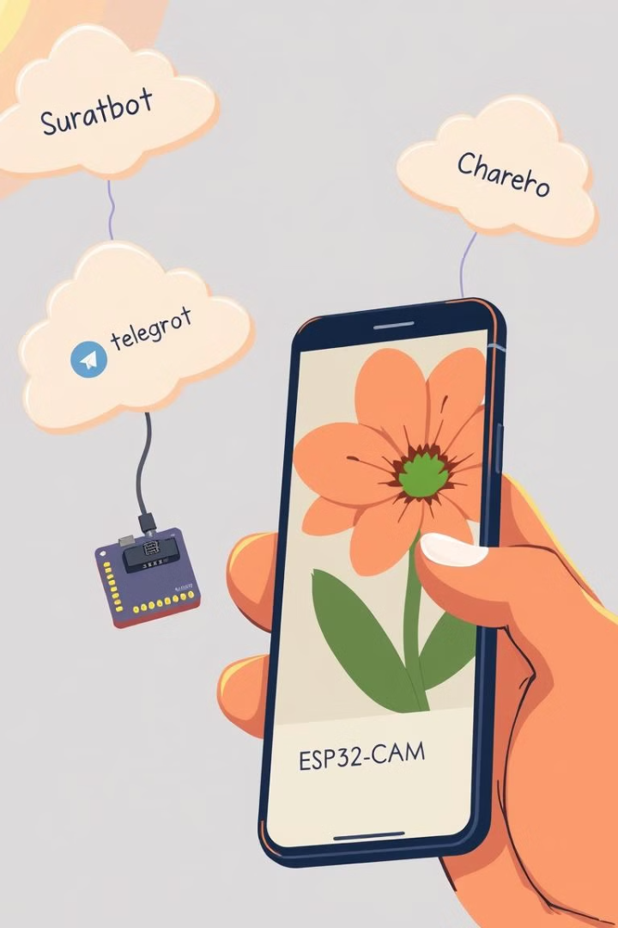


Sending Images to the Telegram Chatbot
Connect to the Telegram Bot API using the obtained token.
Send the captured image data to the chatbot using an HTTP request.

